Slide 1

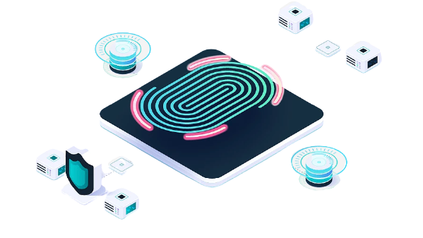
Technical Support
Onboarding Guide

Slide 2

Agenda
Support Basics
Support Access
Designated Correspondent
Ticket Flow
Service Level & Upgrades
RMA

Slide 3

Support Basics
The web portal is your primary resource for Nymi Support.
  Open Support tickets
  Nymi Documentation
  Knowledge base
  Training videos
Access to support
Hours of Operation
Web Portal is available 24/7/365
Nymi Technical Support resources are available 9:00a to 5:30p ET, Monday through Friday to handle new issues
Subsequent engagements can occur on at mutually agreed upon times
https://support.nymi.com
Login required to create and manage tickets
Login not required for access to KB and documentation

Slide 4

Designated Correspondents
Creation of support tickets is limited to designated correspondents
Open tickets from the Nymi Customer Support Portal (preferred)
–or-
Send a support request to support@nymi.com
Designated correspondents are:
  Trained on the Nymi Solution
  Customers must implement internal help desk processes to support the customer’s users/operators
  Designated correspondents begin using the Nymi support portal as part of the transition to production
  Added to a mailing list to receive important communications from Nymi
Customers notify Nymi of changes to designated correspondent(s) and email addresses (including domain name changes)

Slide 5

Support Portal Access
1
2
3
4
5
Designated Correspondent accesses Nymi Support Platform
Correspondent
signs in
Correspondent accesses Private Support Portal, searches KB
Ticket Creation?
Ticket Creation Process
Expectations
Designated Correspondent logs in to the Nymi support portal to search the knowledge base and create/review tickets
Nymi support will respond to or request additional information from the ticket owner
6
7
Ticket Review
Ticket Review
Process

Slide 6

Support Ticket Process
Resolved?
Tier 1 troubleshoots issue with submitter
Y
Fill out Submit Ticket Form
Create kb article/close ticket
N
Y
Y
Tier 2 engaged
Resolved?
Create bug/enhancement request
Y
N
Tier 3 engaged
N
Resolved?
Notes:
Designated Contact (DC) fills out appropriate submit ticket form.
Tier 1 Support works with DC to resolve issue.
If Tier 1 Support cannot resolve or bug suspected, Tier 1 engages Tier 2 Support.
Tier 2 Support works with DC and Tier 1 Support to resolve the issue.
If a defect is confirmed or Tier 2 Support cannot resolve the issue, Tier 2 files a defect and engages Tier 3 Support.
When issue is resolved to customer satisfaction, a knowledge base article is created/linked & ticket closed. If issue requires future changes to the product, a bug or enhancement request is created.

Slide 7
Service Levels
Severity 1 Critical | Operations failure, which prevents Company’s users from performing work and causing significant business impact. | Users of the Nymi Devices cannot access critical Company facilities, systems or perform necessary activities with the Nymi Devices or alternative methods or processes. | 1st Response Within 1 Business Hour | Allocate appropriate resources to sustain continuous effort within standard support hours, rapid access and response from change control authority to implement changes if needed. Company will have enabled alternative methods or processes to continue working, e.g. as manual login.
Severity 2 High | Loss or degradation of at least one mission critical feature or function within Company’s operations such that Company’s personnel cannot reasonably continue without major impairment. | Users of the Nymi Devices cannot reasonably access alternative Company’s facilities or systems, with the Nymi Devices or alternate methods of processes, without materially disrupting operations. | 1st Response Within 4 Business Hours | Allocate appropriate resources to sustain continuous effort within standard support hours, rapid access and response from change control authority to implement changes if needed.
Severity 3 Medium | Loss or degradation of at least one feature or function of Company’s operations; however, Company personnel can reasonably continue in an impaired manner. | Users of the Nymi Devices must use alternative means to access Company’s systems or facilities, in a material less efficient manner. | 1st Response Within 1 Business Day | Allocate appropriate resources to sustain effort within standard support hours.
Severity 4 Low | No Significant Impact on Company’s Operations. | General inquiries, updates on customization, status requests. | 1st Response Within 2 Business Days | Allocate appropriate resources to sustain effort during standard support hours.

Slide 8

Upgrades
Software
Nymi releases new software versions several times per year
Upgrades are covered under your subscription
Nymi support can work with your Nymi administrator to upgrade software
Hardware (Firmware)
Nymi Support:
Helps wth the first few firmware updates
Provides instructions and support as required

Slide 9

RMA Process
Nymi Band wearer contacts your service desk regarding defective Nymi Band.
Your service desk confirms RMA is required and submits a Nymi support ticket, by selecting the RMA Ticket form. Information required includes:
  Nymi Band Serial Number (appears on back of Nymi Band)
  Customer contact name, email, & phone number
  Return address & contact info for replacement, if different from above
Nymi follows up to discuss the issue and if required, sends a replacement Nymi Band.
If required:
  Nymi sends a shipping label to the customer to receive the defective Nymi Band.
  Customer packages and sends the defective device back to Nymi
  Nymi receives the Nymi and performs a Root Cause Analysis(RCA) of the Nymi Band. If desired, Nymi sends the results to the customer.
Customer confirms receipt of the replacement Nymi Band and Nymi closes the support ticket.

Slide 10

Q & A

Slide 11
Thank you

