Slide 1
Building Your Connected Worker Capability Nymi Professional Services
Proprietary & Confidential

Slide 2
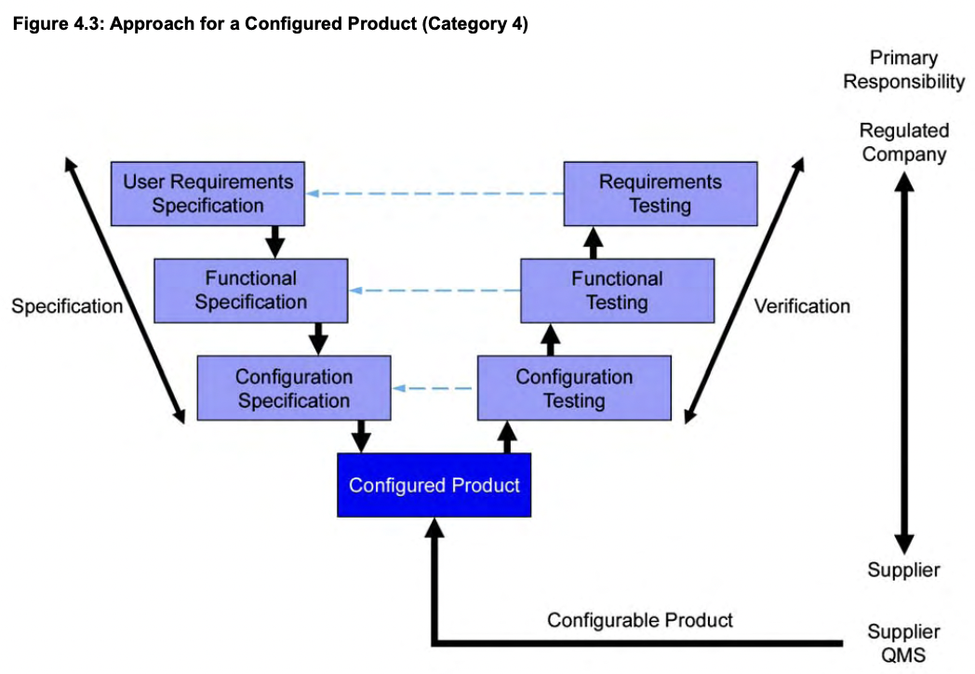
GAMP5 Validation Phases
The Nymi Solution is GAMP5 category 4 product – Configurable Software
As a result, a solution implementation follows a specifically defined approach
Notes:
In the Specifications phase, companies identify the way in which the Nymi solution can improve their processes and the requirements that must be satisfied by the solution (URS)
In the specification phase, Nymi provides functional and configuration specifications to the company to show how the solution satisfies their user requirements.
In the Configured Product, the Nymi and the customer prepare and deploy the Nymi solution in the environment
In the verification phase, the company tests the requirements in Nymi solution to ensure that they are acceptable.

Slide 3
GAMP5 Validation documents for phases
IQ
OQ
PQ
URS
FS
CS
DS
Planning
Specification
Verification
Validated solution!
Nymi has templates of these documents.
https://support.nymi.com/hc/en-us/articles/7544067420052-Connected-Worker-Platform-1-3-Sample-GAMP-Documents
Customer-lead
Nymi-lead
Notes:
A series of documents are used by the pharmaceutical company as they follow the GAMP5 methodology to validate our solution.
The doc creation is predominantly a customer responsibility but Nymi has some too.

Slide 4
URS
IQ
OQ
PQ
URS
FS
CS
DS
User Requirements Specification document
List of requirements that the customer requires to implement Connected Worker Platform.
Customer written & led.
Nymi can assist in the creation.
Validated
solution!

Slide 5
FS
IQ
OQ
PQ
FS
CS
DS
URS
Functional Specifications document.
Provides information about functional specifications in the Nymi solution that address each requirement outlined in the URS.
Nymi written and led.
Validated
solution!

Slide 6
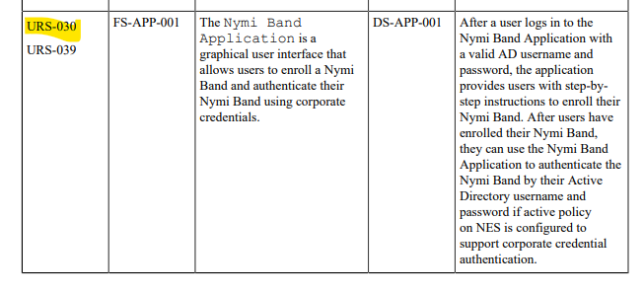
CS
IQ
OQ
PQ
DS
CS
URS
FS
Configuration Specification document.
Provides configuration information when the customer must perform a physical qualification to validate that an FS requirement meets the URS requirement.
Nymi written and led.
NOTE: Not all FS requirements will have a corresponding CS line item

Slide 7
IQ
IQ
OQ
PQ
DS
URS
FS
CS
Installation Qualification document.
Details the customer’s test run that is performed to validate installation-specific requirements that are present in the URS and described in Nymi’s FS and CS responses.
Customer written & led.
Nymi can assist in the creation.
NOTE: Not all requirements require installation testing

Slide 8
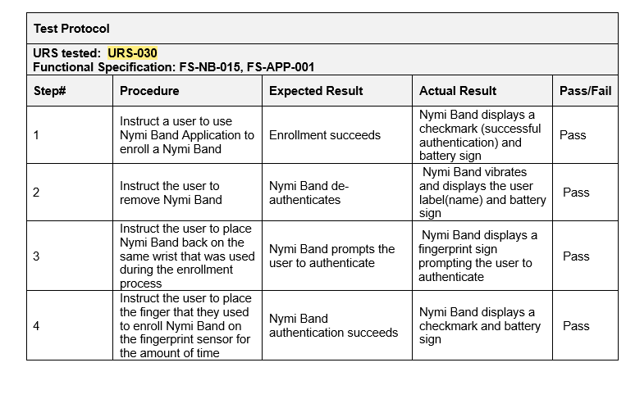
OQ
OQ
IQ
PQ
DS
URS
FS
CS
Operations Qualification document.
Details customer’s test run that is performed to validate operation-specific requirements that are present in the URS and described in Nymi’s FS and CS responses.
Customer written and led.
Nymi can assist in the creation.
NOTE: Not all requirements
require operational testing

Slide 9
PQ
PQ
IQ
oQ
DS
URS
FS
CS
Performance Qualification document.
Details customer’s test runs that is performed to verify that the system consistently performs to the performance-related specifications described in Nymi’s FS and CS responses.
Customer written and led.
Nymi can assist in the creation.
NOTE: Not all requirements require performance testing

Slide 10
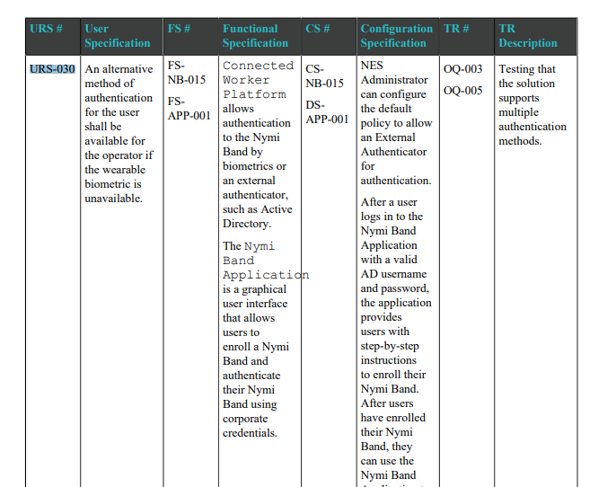
Traceability Matrix
Not a standard GAMP5 validation document but a means to trace URS requirements to FS, CS and test runs.

Slide 11
Questions

